Slide 1
Schedule Planner Website (NTBD)

Slide 2

Goal Of The Website
This website will take in the schedules of everyone in a group and find a time that works best for everyone.

Slide 3
Feature List
Simple design
Owner conditions and settings
Ability to edit schedules
See other’s schedules
Link sharing

Slide 4
Simple Design
An easy to understand, easy to follow interface that makes it simple for anyone of any technological background to use, while also making some of the more advanced features readily accessible.
One-page dynamic web design that takes users from start to finish

Slide 5
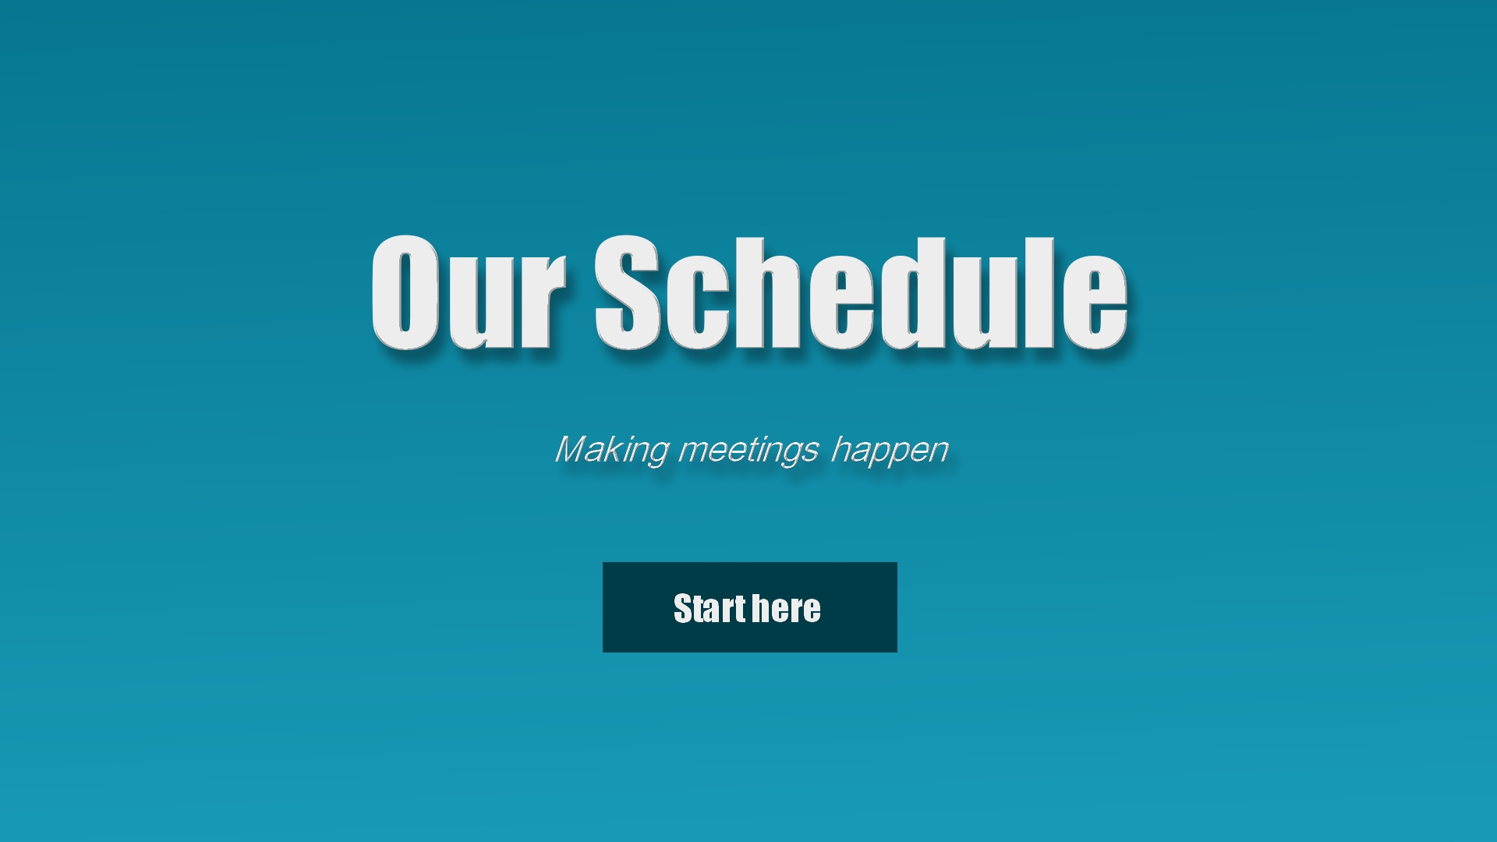

Slide 6
Simple Design
Little to no interference or clutter
Helpful direction for new and inexperienced

Slide 7
Owner Conditions
The schedule owner’s ability to set restrictions, requirements, and preferences

Slide 8
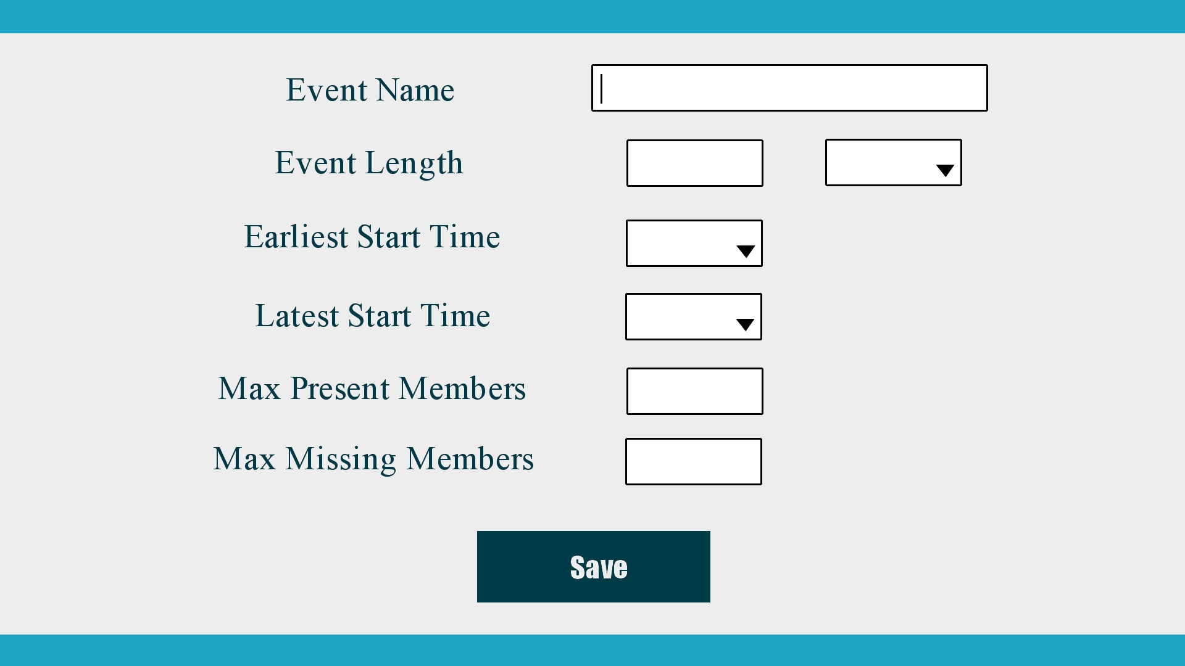

Slide 9
Owner Conditions
Name of the event for organization and easy identification
Length of event to let people know how long the event is
Earliest and latest start times for further restriction
Max members and max absent members to narrow schedule

Slide 10
Edit and See Other Schedules
Schedules will be compiled, viewed , and edited by the owner or approved users

Slide 11
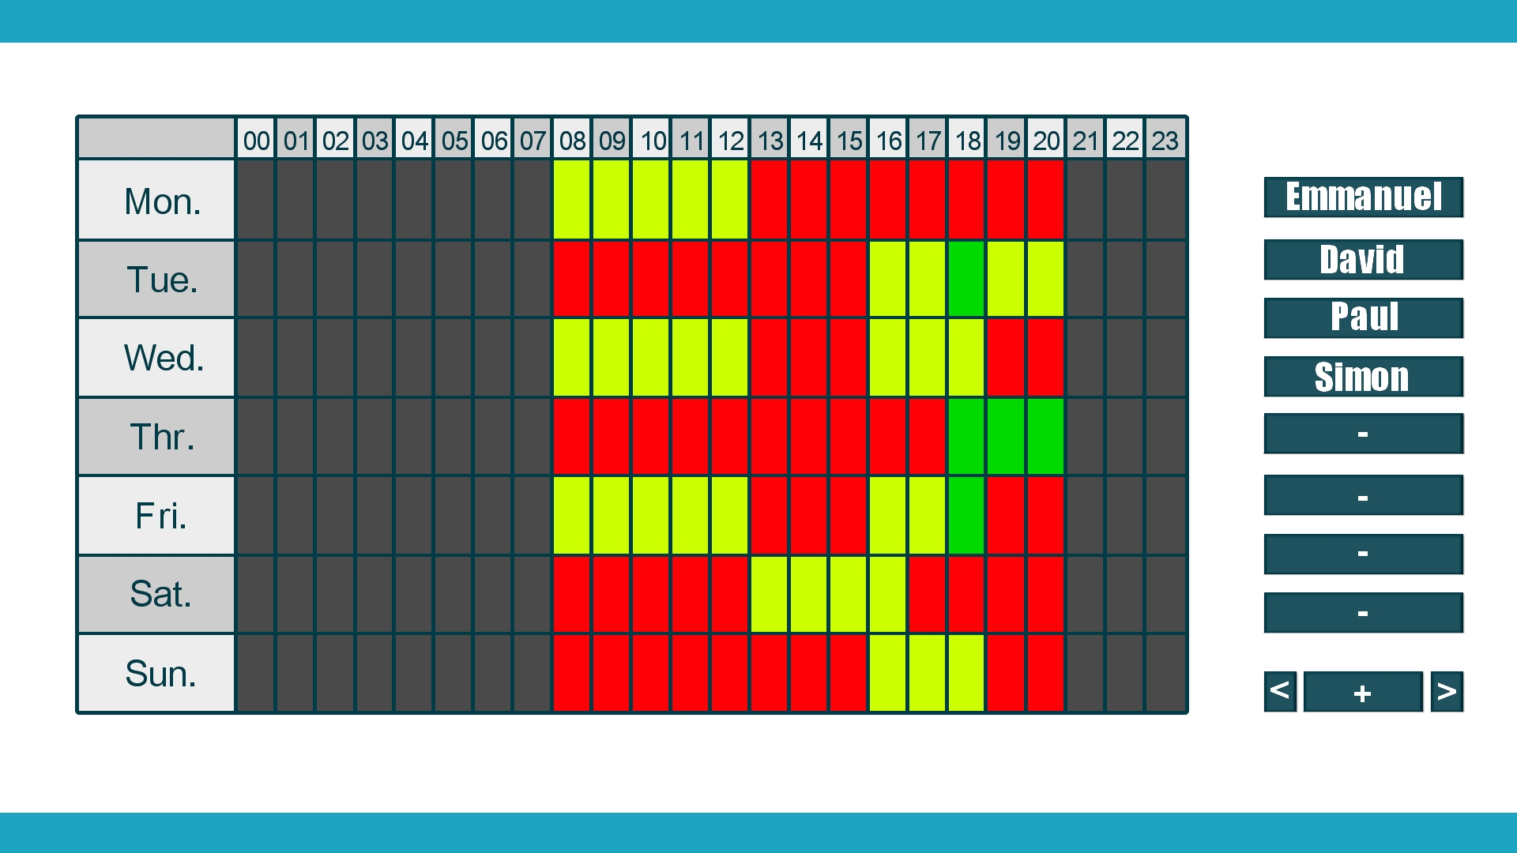

Slide 12
Edit and See Other Schedules
Easy to read display of schedules. Green for everyone is available, yellow for missing members up to max absent members, red for missing more than max absent members, gray for time not made available by owner
Clicking a name will allow to view that individual’s schedule by itself and allow setting to edit the name, schedule, or remove the name entirely

